Slide 1
Afrizal Doewes
Arif Rohmadi
PHP OOP

Slide 2
What is PHP OOP?
OOP stands for Object-Oriented Programming.
PHP OOP (Object-Oriented Programming) is a programming paradigm in PHP that organizes code around objects rather than standalone functions and data. In PHP, an object is an instance of a class—a user-defined blueprint that bundles data (properties) with behavior (methods)
OOP helps you write modular, reusable, and easier-to-maintain code by modeling real-world entities and their relationships.

Slide 3
Why PHP - OOP?
Object-oriented programming has several advantages over procedural programming:
- OOP is faster and easier to execute
- OOP provides a clear structure for the programs
- OOP helps to keep the PHP code DRY "Don't Repeat Yourself", and makes the code easier to maintain, modify and debug
- OOP makes it possible to create full reusable applications with less code and shorter development time

Slide 4
Core Building Block PHP OOP
Concept | Description | PHP Syntax / Keywords | Example
Class | Blueprint defining properties and methods | class | class Car { }
Object | An instance of a class | new | $myCar = new Car();
Property | Variable that holds data specific to an object | public $brand; | $this->brand = "Toyota";
Method | Function inside a class that defines behavior | public function drive() {} | $this->drive();
Constructor | Special method automatically called on object creation | __construct() | function __construct($brand) {}
Encapsulation | Restrict access to internal object state | public, private, protected | private $mileage;
Inheritance | Child class inherits properties and methods from parent | extends | class Truck extends Car {}
Polymorphism | Same method behaves differently in different classes | Method overriding | function honk() {} in subclass
Abstraction | Define abstract methods or contracts without implementation | abstract class, interface | abstract function startEngine();
Interface | Contract that classes must implement | interface, implements | class Tesla implements ElectricCar {}
Trait | Reusable set of methods to be included in multiple classes | trait, use | trait Logger { function log() {} }
Static | Belongs to class rather than instance | static | public static function countAll() {}
Final | Prevent method or class from being overridden or extended | final | final class SecureCar {}
Visibility | Controls access from outside or inside class | public, private, protected | protected function repair() {}

Slide 5
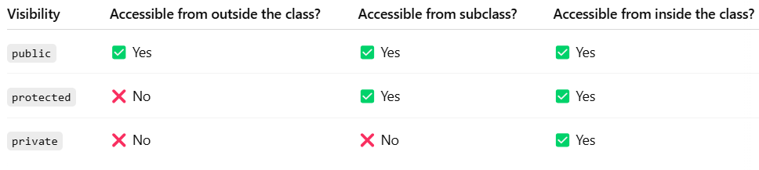
Difference Between Public, Protected, and Private

Slide 6
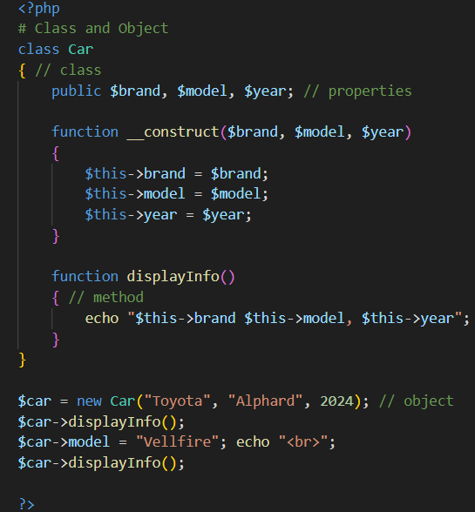
Class and Object

Slide 7
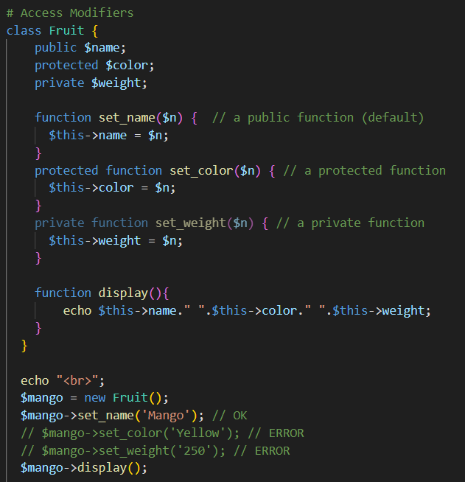
Access Modifiers

Slide 8
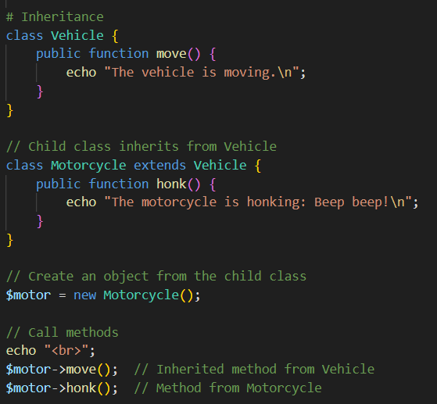
Inheritance

Slide 9
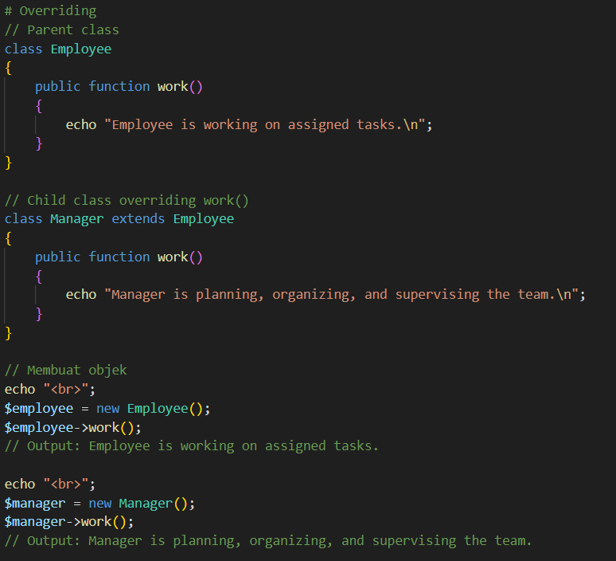
Overriding

Slide 10
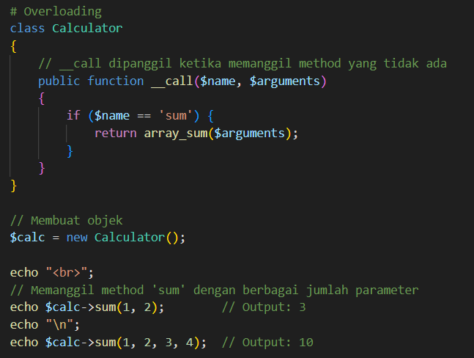
Overloading

Slide 11
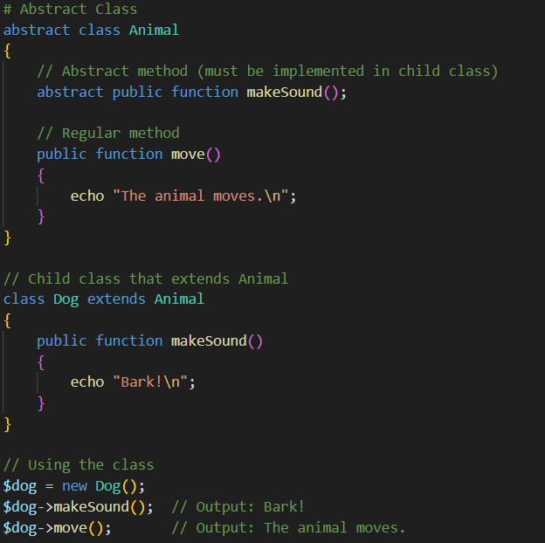
Abstract Class

Slide 12
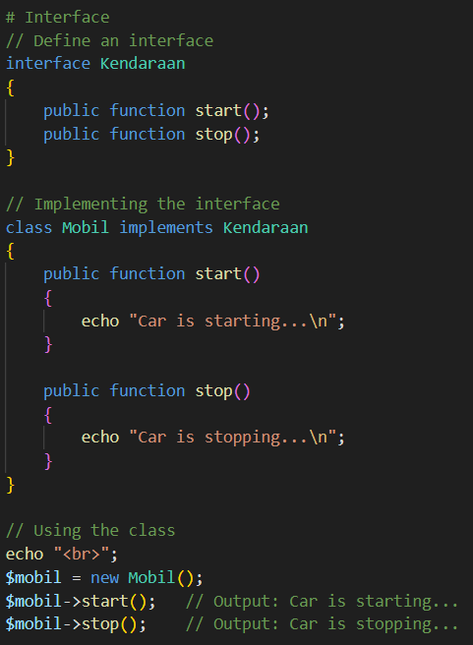
Interface

Slide 13
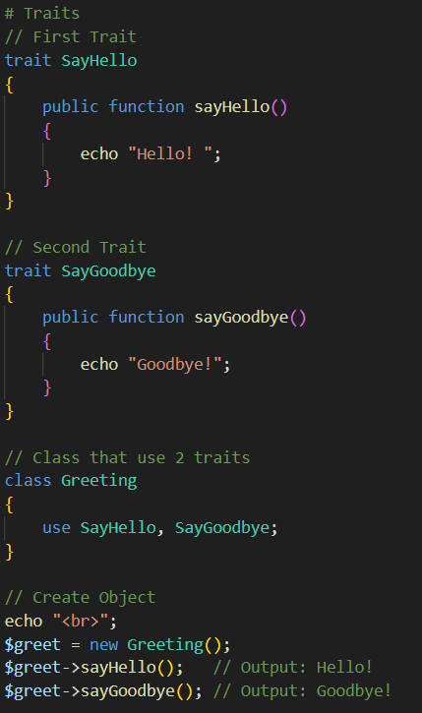
Traits
PHP only supports single inheritance: a child class can inherit only from one single parent.
So, what if a class needs to inherit multiple behaviors? OOP traits solve this problem

